Slide 1
Selenium and You Jerimy Tate

Slide 2
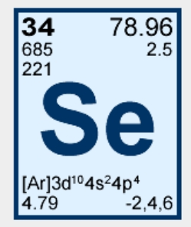
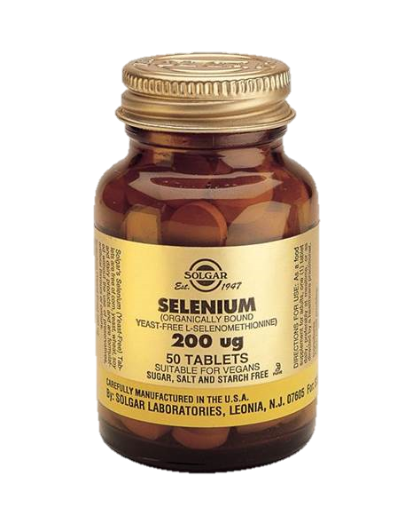
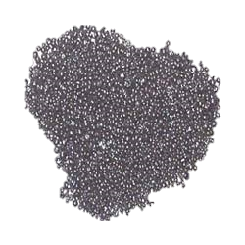
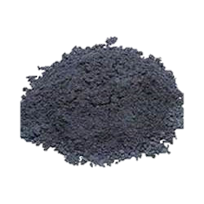
What is Selenium?
Selenium is a chemical element with symbol Se and atomic number 34. It is a nonmetal with properties that are intermediate between those of its periodic table column-adjacent chalcogen elements sulfur and tellurium.

Slide 3
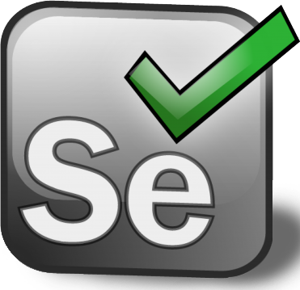
What ELSE is Selenium?
Selenium is a portable open source software testing framework for web applications.
It includes an IDE for action recording, and a robust domain specific language for writing more complex scripts.

Slide 4
History of Selenium
Developed by Jason Huggins at ThoughtWorks in 2004 as a Java Script Test Runner
By the end of 2004 it had moved to open source, and collaborators were adding more language support

Slide 5
History of Selenium Cont.
By 2007 Google had adopted Selenium as well as Facebook
As of today its use grew to include many of the big web companies including IBM, LinkedIn, Salesforce, Mozilla, eBay

Slide 6
Selenium – The Software
Three different pieces of software with the Selenium framework
Selenium WebDriver
Selenium IDE
Selenium Grid
Selenium IDE – Firefox add-on that has recording and playback capabilities that you can do point and click recording of each scenario
Selenium WebDriver – An API that allows you to write test scripts in many languages (C#, Java, Ruby, Python, Perl, etc) that interact with browser directly with many different types of browsers. (IE10, Chrome, Firefox, Opera, Netscape Navigator)
Selenium Grid – Server logic for writing scripts that are ran on multiple machines simultaneously

Slide 7
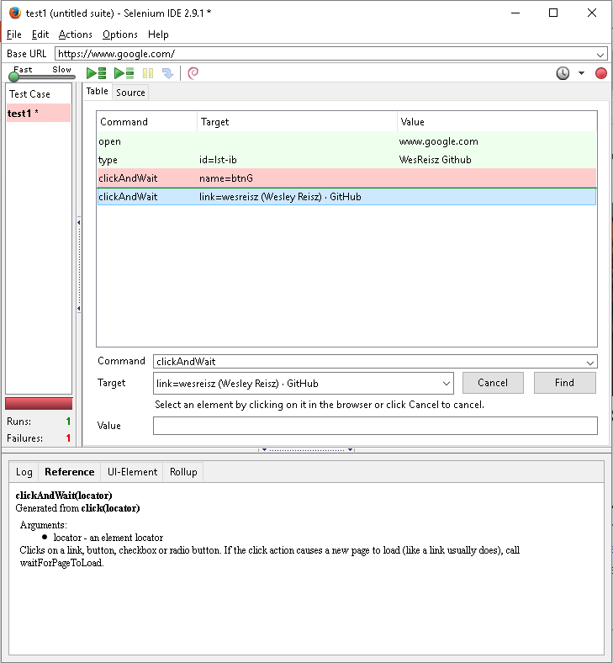
Selenium IDE
Start recording in Selenium IDE
Execute scenario on running web application
Stop recording in Selenium IDE
Verify / Add assertions
Replay the test.

Slide 8
Selenium IDE – Use Cases
Create quick bug reproduction scripts
Create scripts to aid in automation-aided exploratory testing
Quickly automate arduous and repetitive tasks

Slide 9
Selenium IDE - Downsides
Can run the tests only on Firefox
No Programming logic (like loops, conditional statements
It is difficult to use Selenium IDE for checking complex test cases involving dynamic contents

Slide 10
Selenium WebDriver
API that makes calls to a browser.
You can write it in your favorite language
Loops and complicated tests are performed easily
Its way more fun to code, than manually click buttons!

Slide 11
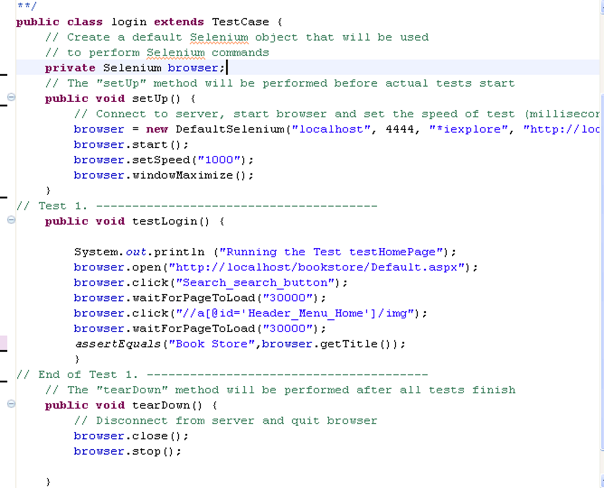
WebDriver - Sample Code

Slide 12
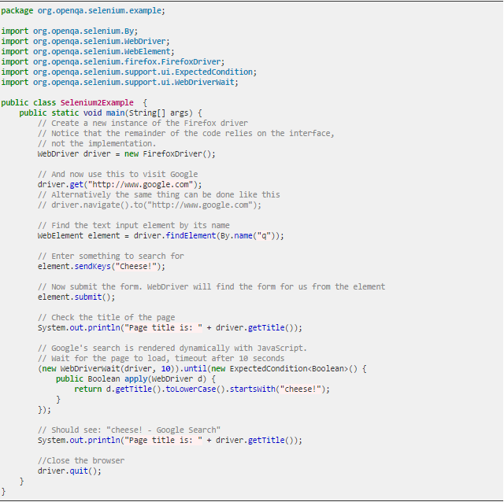
WebDriver – More Code

Slide 13
WebDriver – Benefits
Low Cost Tool
Choice of Language
Multiple Testing Frameworks
Easy to Integrate With Testing Ecosystem
Open for Enhancement (extensible)
Test Driven Development

Slide 14
WebDriver - Downsides
Strictly web only, doesn’t interact with programs.
Interacting with Java Forms/Flash/ and can also be tricky.
Requires some level of programming knowledge(Average users can’t create test scripts)
Slower than your normal unit tests

Slide 15
Selenium Grid
Selenium-Grid allows the Selenium to scale for test suites or test suites to be run in multiple environments.
Allows you to create multiple tests on multiple machines running in parallel.

Slide 16
Why Use Selenium?
QA Testing is mandatory, but it is also no fun
Manual QA is even less fun!
Sending out buggy software is the least fun of all!
Unintended consequences grow greatly as code base grows

Slide 17
Why Use Selenium?
Creating robust and versatile testing that can be ran on many different browsers and written in many different languages allows you to do more coding and less manual tests!

Slide 18
Selenium and Continuous Integration
Jenkins – Plugin for Jenkins available to kick off test suite when code is migrated
Maven – Integration with Maven to provided automated test suites

Slide 19
This is great I want it now!
How to get started!
Download: http://docs.seleniumhq.org/
Very good documentation in 7 different languages!
http://docs.seleniumhq.org/docs/

Slide 20

Sources (list them)
https://en.m.wikipedia.org/wiki/Selenium_(software)#Selenium_WebDriver
http://docs.seleniumhq.org/

